Slide 1


Slide 2
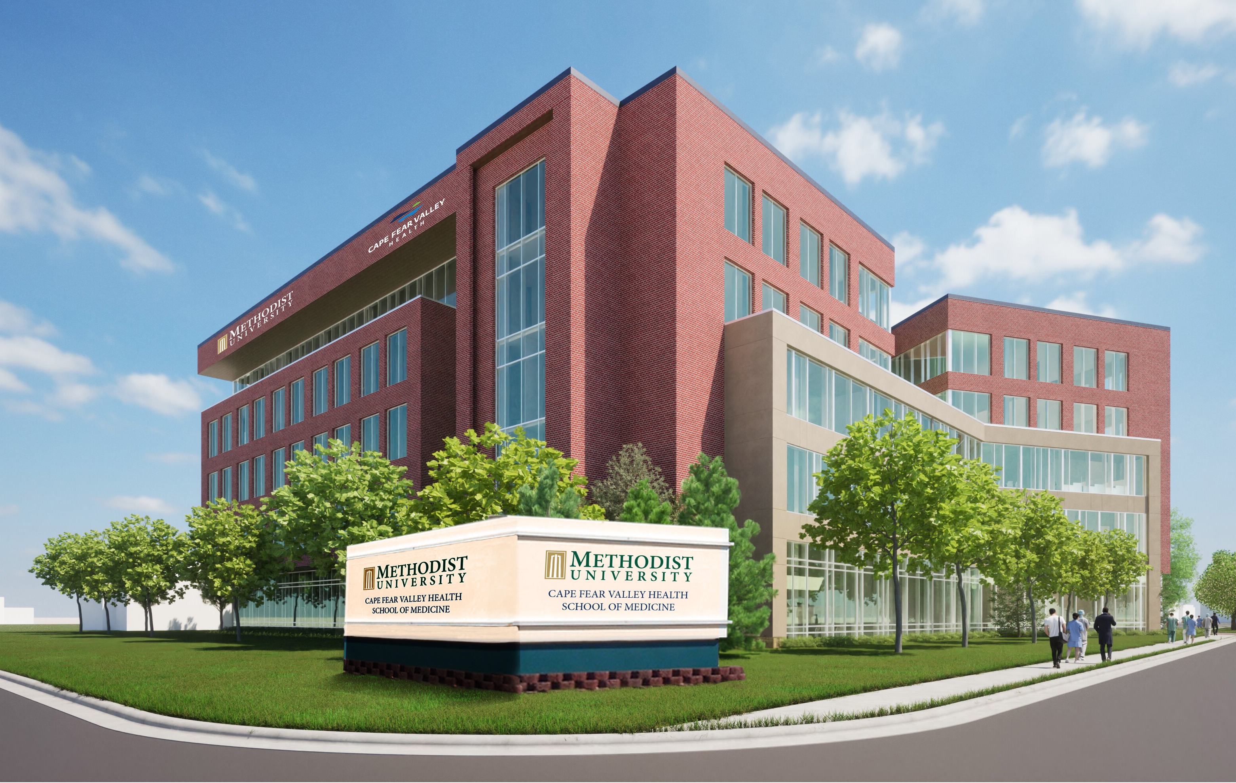
Shown: Rendering

Slide 3

Quick Facts
Located in Fayetteville, North Carolina
Approximately 2,300 enrolled students
80+ undergraduate and graduate programs
28 fully online degree and certificate programs
12:1 student-to-faculty ratio
97% of students receive financial aid
50+ countries represented by current international students

Slide 4
More Quick Facts
No. 1 Most Diverse Campus in North Carolina in 2021-22 and 2022-23 (Niche Rankings)
1 of 10 “Must Watch” North American Colleges and Universities in 2022 (Higher Education Digest)
Consistently named a “Military Friendly” and “Best for Vets” institution
75+ student organizations and honor societies
20 NCAA Division III intercollegiate sports

Slide 5
New Medical School
Partnership between Methodist University and Cape Fear Valley Health created in Feb. 2023
State-of-the-art medical school will train the next generation of health care professionals
Currently an applicant program with the Liaison Commission on Medical Education (LCME)
Projected to begin classes in July 2026, pending approval from LCME and SACSCOC

Slide 6
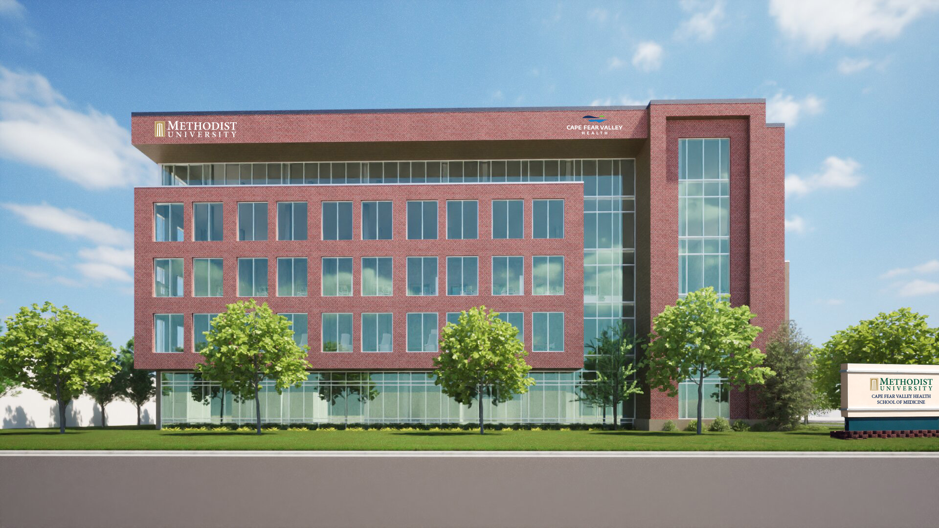
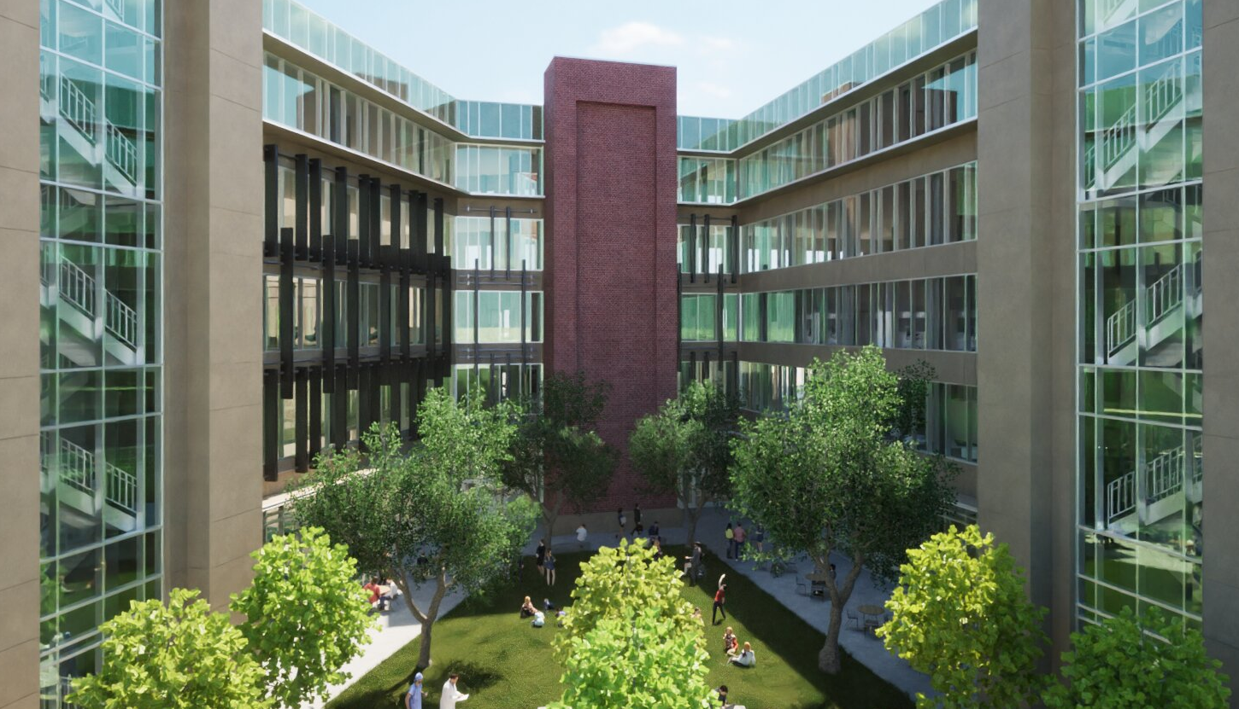
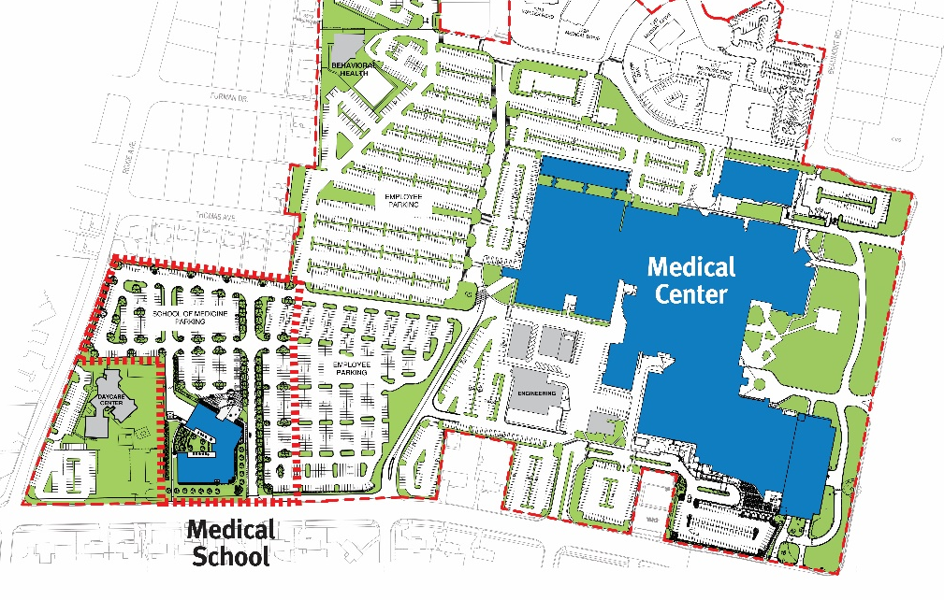

Slide 7
Questions?

